Slide 1
Encrypted Search
Enabling standard information retrieval techniques for several new secure index types while preserving confidentiality
Alex Towell (atowell@siue.edu)

Slide 2
Motivation for Encrypted Search
Who is it for?
Notes:
Reliable
Scalable
Cost-effective
Accessible
Organizations trust cloud storage providers (CSP) with storage logistics but not with confidentiality.

Slide 3
Naïve solution to confidentiality
Use standard encryption
Client encrypts documents before uploading to untrusted system
To search encrypted documents:
Download them to a trusted machine
Decrypt them
Search through them
Primary problem: Time consuming

Slide 4
Encrypted Search: efficient solution to confidentiality
What we want: Give untrusted system (CSP) ability to search confidential documents on behalf of clients without disclosing any information, except which documents are relevant to the search
CSP performs oblivious searching on behalf of authorized clients
CSP doesn’t know what the query is, nor what the confidential documents contain
CSP cannot meaningfully search on its own
Can only search on behalf of authorized clients
Something that meets these requirements is called…
Encrypted Search

Slide 5
Overview
New secure indexes based on Perfect Hash Filter (PHF)
Encrypted Search facilitated by secure indexes.
Standard information retrieval with confidentiality
BM25
MinDist
Protecting confidentiality against a determined adversary
Query privacy
Document confidentiality

Slide 6
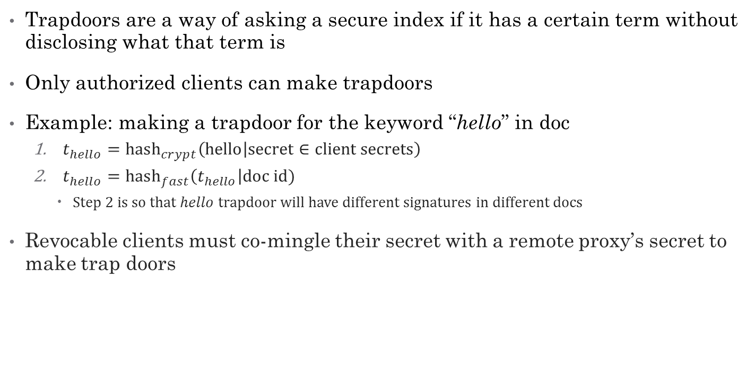
Trapdoors
Trapdoors are a way of asking a secure index if it has a certain term without disclosing what that term is
Only authorized clients can make trapdoors
Example: making a trapdoor for the keyword “hello” in doc
$t_{hello}={\text{hash}}_{crypt}\left(hello | \text{secret}∈\text{client} \text{secrets}\right)$
${t_{hello}=\text{hash}}_{fast}\left(t_{hello}\right|\text{doc} \text{id})$
Step 2 is so that $hello$ trapdoor will have different signatures in different docs
Revocable clients must co-mingle their secret with a remote proxy’s secret to make trap doors
Notes:
${\text{hash}}_{crypt}$ is cryptographic hash function, e.g., SHA256
${hash}_{fast}$ is fast hash function that distributes keys uniformly, e.g., JenkinsHash
Revocability: introduce intermediate step where we mix in a remote proxy’s secret, which is unknown to the client, so that the client must cooperate with the proxy to make trapdoors.

Slide 7
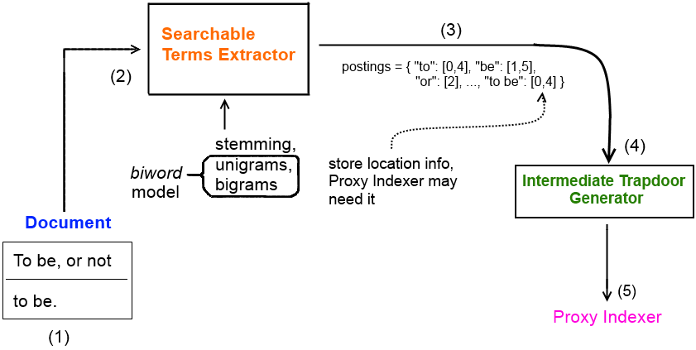
Document processor: trapdoor extraction
Document Processor extracts intermediate trapdoor signatures from doc
Uses a biword model for exact phrase search
make trapdoors for unique unigrams and bigrams
decompose exact phrases in queries to a chain of bigrams
more on this later

Slide 8
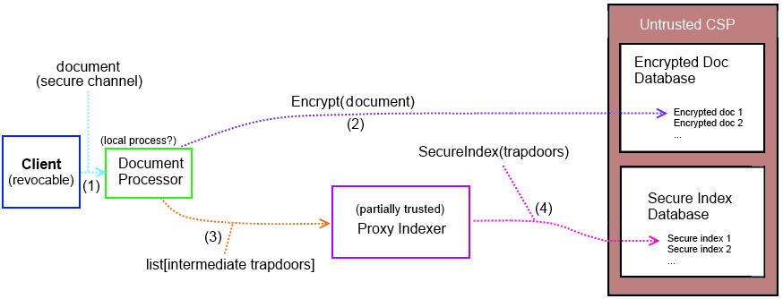
Overview: secure index construction

Slide 9
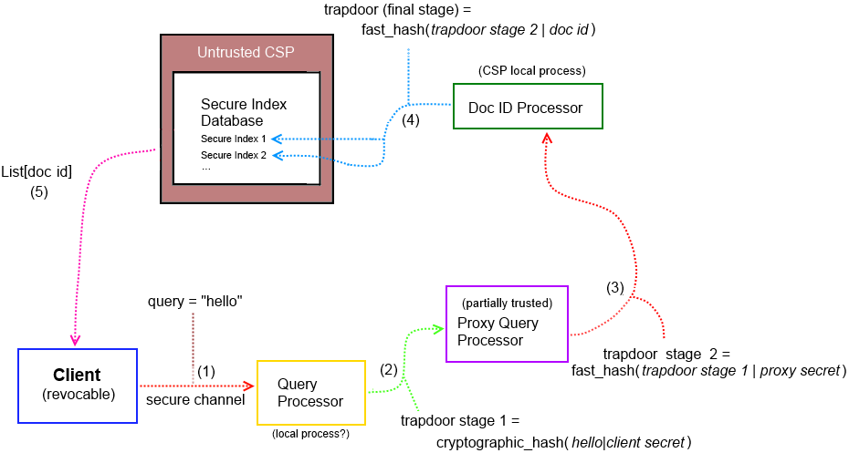
Overview: searching secure indexes

Slide 10
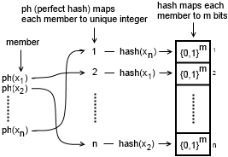

Perfect Hash Filter (PHF)
PHF $∈$ probabilistic set
Composition of perfect hash (ph), normal hash, and a bit vector for storing hash values from the normal hash
False positive rate $ε=\frac{1}{2^{m}}$
Assuming good hash function
Space complexity of size $n$ set
$2.06n+{nlog}_{2}{\frac{1}{ε}=}n(2.06+m)$
Assuming perfect minimal hash
Use PHF as basis for several secure index types
Notes:
Maps each member of set to a unique integer – no collisions among members.
How can this be done? A naïve way of doing it is just to try different hash functions on the members until they result in no collisions.

Slide 11
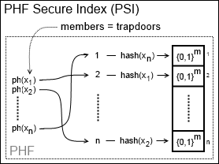

PHF Secure Index (PSI)
Based on PHF, just with trapdoors (for doc) as its $n$ members
Space complexity = $n\left(2.06+m\right)$
No frequency/location info
Boolean search only
Exact phrase search using biword model
doc = “a b b d” query = “a b b” $→$ has “a b” and “b b”
…but biword false positive occurs for query = “a b d”
Larger phrase $↔$ lower biword false positive rate

Slide 12
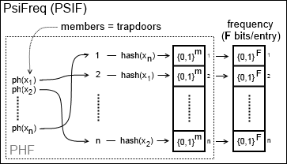

PsiFreq (PSIF)
Composition of PHF + bit vector, for storing frequencies
No location info stored
Compactly stores freq info in $F$ bits per trapdoor
Approximate freq for positive phrases $>2$ words
Phrase $p$ frequency:
extract bigrams from $p$ and bigram with min freq is upper-bound

Slide 13
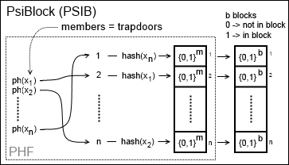

PsiBlock (PSIB)
PHF + bit vector for storing approximate locations
implicitly stores approximate frequencies
Segment doc into $b$ blocks
Map each trapdoor to $b$ bits, each bit represents an approximate position
If trapdoor is in a block, make corresponding bit a 1
Inefficient for large $b$
Sparse bit vector

Slide 14
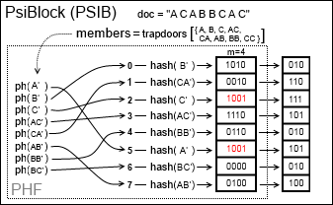
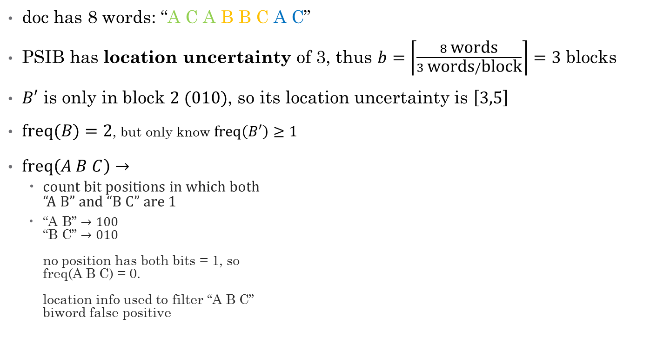
PSIB example
doc has 8 words: “A C A B B C A C”
PSIB has location uncertainty of 3, thus $b=\left\lceil \frac{8 \text{words}}{3 \text{words}/\text{block}}\right\rceil =3$ blocks
$B′$ is only in block $2 (010)$, so its location uncertainty is $\left[3,5\right]$
$\text{freq}(B)=2$, but only know $\text{freq}\left(B′\right)≥1$
$\text{freq}\left(A B C\right)→$
count bit positions in which both “A B” and “B C” are 1
“A B” $→100$ “B C” $→010$ no position has both bits = 1, so freq(A B C) = 0. location info used to filter “A B C” biword false positive
Notes:
Fast bit-wise operations possible (AND)

Slide 15
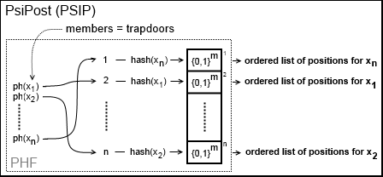
PsiPost (PSIP)
Composition of PHF + postings list
locations – store a scrambled list of positions for each trapdoor
each position is randomly offset up to a max radius of uncertainty
locations of phrase are where all its bigrams are within location uncertainty size
frequency: size of a trapdoor’s list of positions

Slide 16

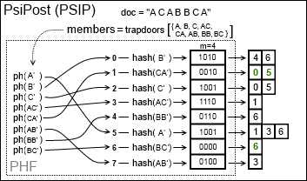

PSIP example
doc =
locations(B C A )?
locations(B C) = { 6 }, locations(C A) = { 0, 5 }
If a location for “B C” and a location for “C A” is $≤2×\text{radius}=4$, count as hit
B C @ 6 and C A @ 0? No.
B C @ 6 and C A @ 5? Yes.
$6−5≤4$
Take mean position of bigrams to be position of “B C A” $→5.5$

Slide 17
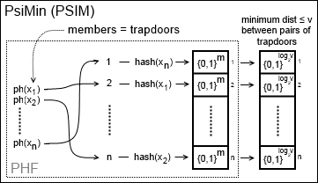

PsiMin (PSIM)
Composition of a PHF + a bit vector to represent the minimum pairwise distance between trapdoors
minimum distance must be less than threshold distance $v$, otherwise ignored
trapdoors are pairs of keywords $→$ “hello|world”
Compliment to other secure indexes
give them extra sensitivity to nearby trapdoors

Slide 18
Evaluating Encrypted Search information retrieval (IR) performance
How effective is our Encrypted Search scheme?
Many ways to measure effectiveness
Time-complexity – latency
Space-complexity – how many secure indexes can fit into system memory?
Search retrieval accuracy

Slide 19
Time complexity performance
How long does it take IR system to respond to query?
Most users aren’t willing to wait much longer than a second
PSI-derived indexes: O(1) as expected
BSIB indexes: O(n) (proportional to # blocks)
For large collections, BSIB too slow?
~80k docs > 1 sec (~60 pages/doc)
Notes:
One of the primary reasons for PSI-based secure indexes.

Slide 20

Space complexity performance
How much memory do the secure indexes with $n$ trapdoors require?
PSIB: $n\left\lceil 2.06+\log_{2}{\frac{1}{ε}}+b\right\rceil$
$b$ is location uncertainty
PSIF: $n\left\lceil 2.06+\log_{2}{\frac{F}{ε}}\right\rceil$
$F$ is maximum frequency
PSIP: $n\left\lceil 2.06+\log_{2}{\frac{1}{ε}}\right\rceil +O\left(n\overline{f}\right)$
$\overline{f}$ is average frequency
PSIM: $O(vw)\left\lceil 2.06+\log_{2}{\frac{v}{ε}}\right\rceil$
$w$ is # word positions
BSIB: $\left\lceil (1.44n+r)\log_{2}{\frac{1}{ε}}\right\rceil$
$r$ is # bits needed per hash seed

Slide 21
Measuring search retrieval accuracy
Encrypted Search retrieves documents in response to queries
How good is this response?
Operationally defined relevant (“true”) results for a given query and document collection as the documents retrieved from by canonical indexes
Canonical indexes: non-secures index which store exact information
To measure Encrypted Search retrieval accuracy, we compare its retrieved results with the relevant (canonical) results.
Boolean search: precision and recall
Degrees of relevancy search: mean average precision (MAP)
Basically, measure how close Encrypted Search is to canonical search

Slide 22
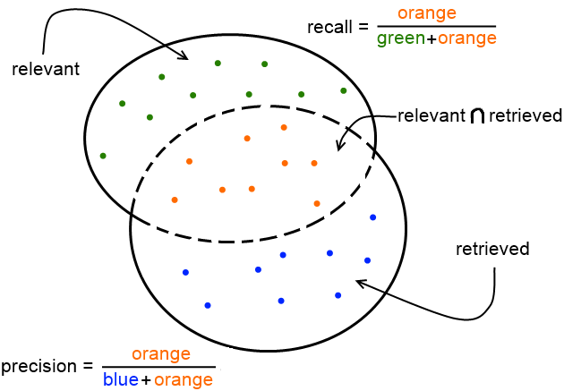

Boolean search
Boolean search
Either a doc is relevant or irrelevant
$\text{precision}=\frac{\left\{\text{relevant}\right\}∩\{\text{retrieved}\}}{\{\text{retrieved}\}}$
$\text{recall}=\frac{\left\{\text{relevant}\right\}∩\{\text{retrieved}\}}{\{\text{relevant}\}}$
Trivial to get 100% recall by retrieving everything.
Generally a trade-off between recall and precision

Slide 23
Boolean search
0.001 false positive rate
More words in phrase, more precision
All converge to 100% for large phrases
More terms, less recall
PSIB/BSIB especially, but can be improved

Slide 24
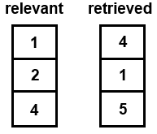
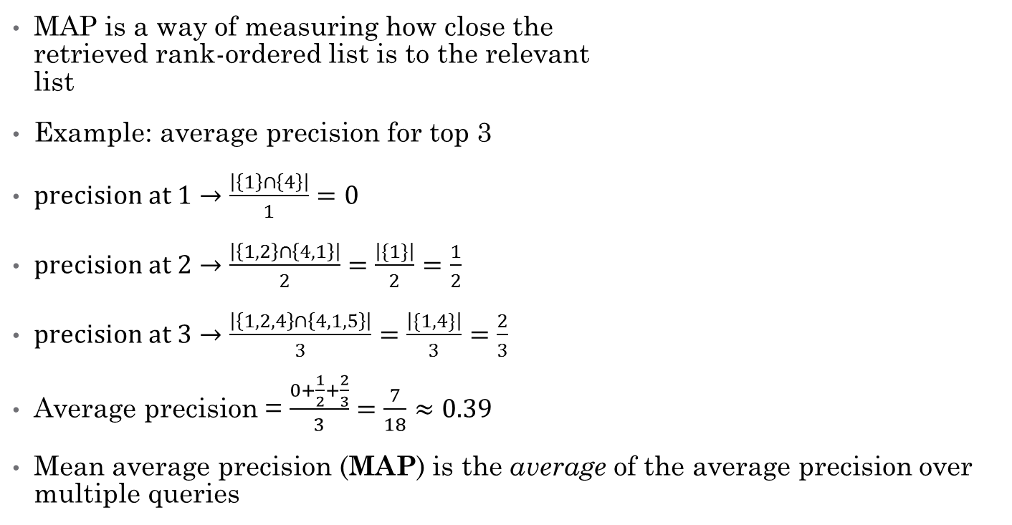
Measuring accuracy of rank-ordered searches
MAP is a way of measuring how close the retrieved rank-ordered list is to the relevant list
Example: average precision for top 3
$precision at 1→\frac{\left|\left\{1\right\}∩\left\{4\right\}\right|}{1}=0$
$precision at 2→\frac{\left|\left\{1,2\right\}∩\left\{4,1\right\}\right|}{2}=\frac{\left|\{1\}\right|}{2}=\frac{1}{2}$
$precision at 3→\frac{\left|\left\{1,2,4\right\}∩\left\{4,1,5\right\}\right|}{3}=\frac{\left|\{1,4\}\right|}{3}=\frac{2}{3}$
Average precision = $\frac{0+\frac{1}{2}+\frac{2}{3}}{3}=\frac{7}{18}≈0.39$
Mean average precision (MAP) is the average of the average precision over multiple queries

Slide 25

BM25 rank-ordered search
Term weighting heuristic
Rare terms (in collection) important
Frequent terms (in doc) important
Out of 1000 documents, retrieve top 10 most relevant. What is MAP?
For PSIB/BSIB, MAP $≥80\%$ if location uncertainty$<250$
BM25 tolerant of approximate frequencies
For, PSIP/PSIF, MAP ~97%
Independent of location uncertainty
All converge to ~97% as location uncertainty converges to 5 words

Slide 26

MinDist rank-ordered search
Term proximity heuristic
Terms in close proximity are relevant to each other
Relevancy quickly diminishes with distance
Out of 1000 documents, retrieve top 10 most relevant. What is MAP?
MinDist* very sensitive to location uncertainty
For MAP accuracy $>70\%$ PSIP location uncertainty $≤2$0 and PSIB/BSIB $≤10$
This is dangerous, especially for PSIB/BSIB
PSIM to the rescue?

Slide 27
Protecting confidentiality
Already measured Encrypted Search’s traditional information retrieval performance
What about its performance at providing confidentiality?
We consider two types of confidentiality
Contents of queries -- query privacy
Contents of documents -- document confidentiality

Slide 28
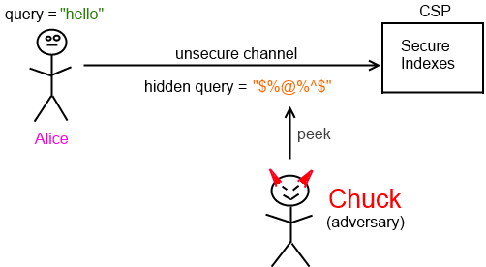
Query privacy
Query privacy not seriously considered in the context of an adversary who has access to query history data
Start with a plaintext query
query = “hello”
Convert into a hidden query (trapdoor)
hidden query = hash(hello|secret)
Is this good enough?
Query privacy is one of the weakest links in the chain
Hidden queries (trapdoors) are a substitution cipher

Slide 29
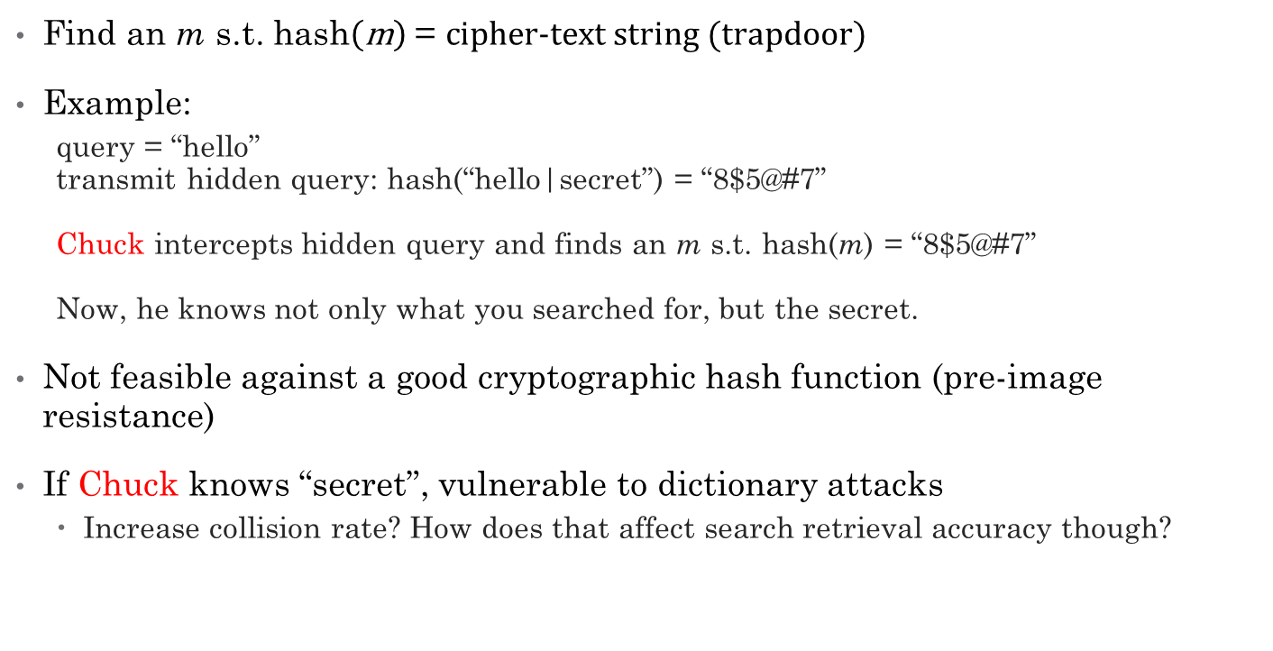
Cryptographic hash attacks
Find an m s.t. $\text{hash}\left(\text{m}\right) \text{=} \text{cipher}\text{−}\text{text} \text{string}\text{ (}\text{trapdoor}\text{)}$
Example:
query = “hello” transmit hidden query: hash(“hello|secret”) = “8$5@#7” Chuck intercepts hidden query and finds an m s.t. hash(m) = “8$5@#7” Now, he knows not only what you searched for, but the secret.
Not feasible against a good cryptographic hash function (pre-image resistance)
If Chuck knows “secret”, vulnerable to dictionary attacks
Increase collision rate? How does that affect search retrieval accuracy though?

Slide 30

Maximum likelihood estimate (MLE) attacks
Suppose Chuck doesn’t know “secret”
Estimate plaintext word distribution f
Simple bag-of-words model (f ~ Zipf)
More sophisticated models possible
Find a function $\tilde{g}$ that maps cipher-text to plaintext so that probability of seeing those ciphers is maximized
$\tilde{g}=\underset{g}{argmax}{\prod{f(g\left(cipher\right))}}$
Chuck is 100% accurate with sufficient data
Can spy on users
Can perform Encrypted Searches

Slide 31
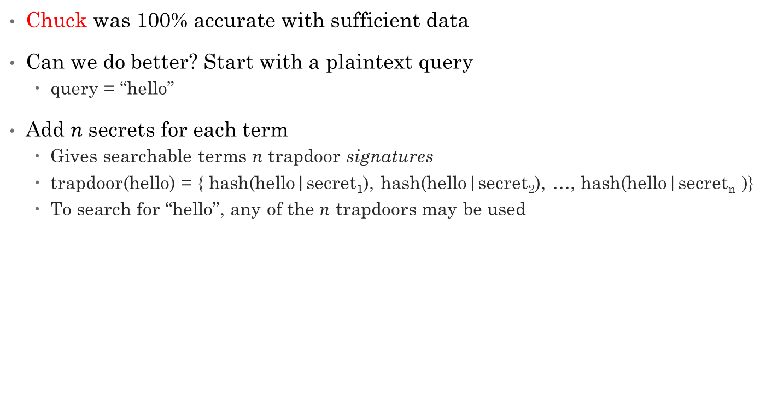
Mitigating MLE attacks with multiple secrets
Chuck was 100% accurate with sufficient data
Can we do better? Start with a plaintext query
query = “hello”
Add $n$ secrets for each term
Gives searchable terms $n$ trapdoor signatures
trapdoor(hello) = { hash(hello|secret₁), hash(hello|secret₂), …, hash(hello|secret_{n} )}
To search for “hello”, any of the $n$ trapdoors may be used

Slide 32

Effect of multiple secrets on query privacy
Chuck (the adversary) is still 100% accurate when given 10 million trapdoors to learn $\tilde{g}$
He can still spy on users
He can still perform Encrypted Searches
Can we do better?

Slide 33
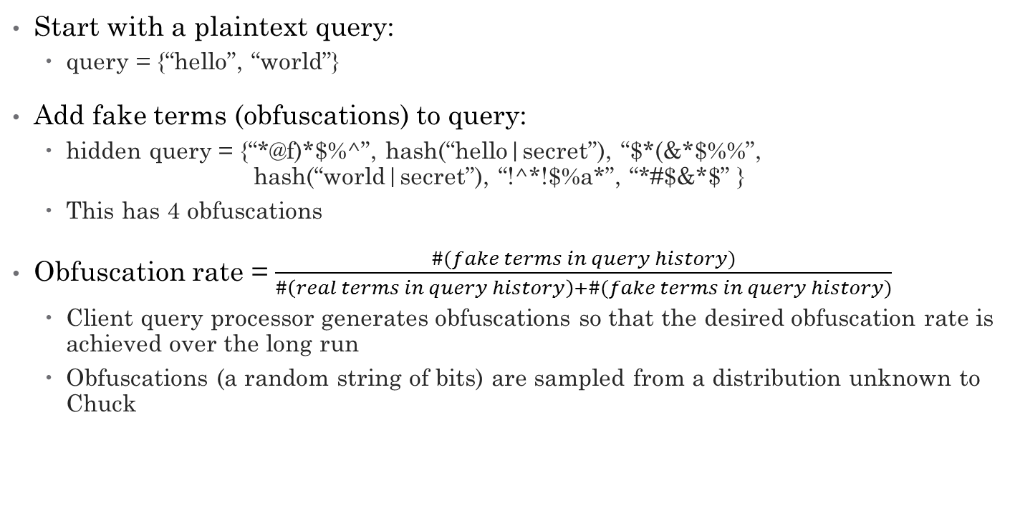
Mitigating MLE attacks with obfuscations
Start with a plaintext query:
query = {“hello”, “world”}
Add fake terms (obfuscations) to query:
hidden query = {“*@f)*$%^”, hash(“hello|secret”), “$*(&*$%%”, hash(“world|secret”), “!^*!$%a*”, “*#$&*$” }
This has 4 obfuscations
Obfuscation rate = $\frac{\#(fake terms in query history)}{\#\left(real terms in query history\right)+\#(fake terms in query history)}$
Client query processor generates obfuscations so that the desired obfuscation rate is achieved over the long run
Obfuscations (a random string of bits) are sampled from a distribution unknown to Chuck

Slide 34
Effect of obfuscations on query privacy
Chuck not very successful when obfuscations are used Why?
MLE may favor mapping an obfuscation to a real term and a real term to an obfuscation
…since Chuck doesn’t know distribution of obfuscations
Also, curse of dimensionality

Slide 35

Obfuscation rate vs search accuracy
How does obfuscation rate affect search retrieval accuracy?
BM25 MAP affected very little if obfuscation rate $≤$ 0.5
Higher obfuscation rate not necessarily better
There’s a sweet spot.
Same story for MinDist*
However, Boolean (AND) search incompatible

Slide 36
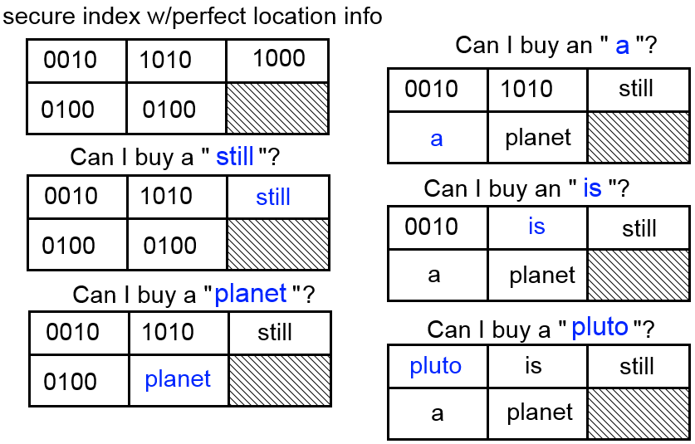
Document confidentiality
If secure index contains exact location info, confidentiality easily broken
Wheel of Fortune
As words are put into place, try new words intelligently
Trigram language model P[planet|still a]
This is why we only store approximate location info (PSIM may store exact min pairwise dist info though)

Slide 37
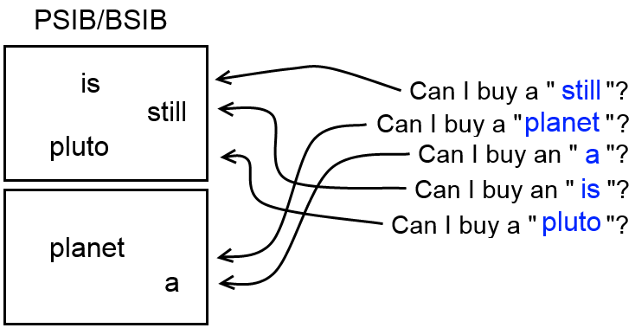
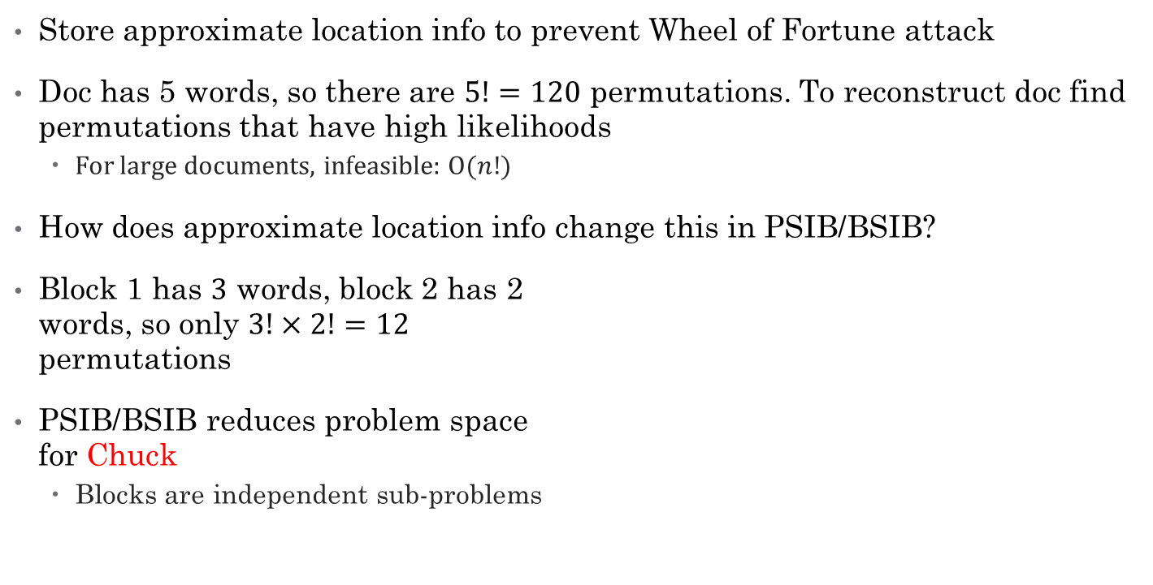
PSIB/BSIB approximate location information
Store approximate location info to prevent Wheel of Fortune attack
Doc has 5 words, so there are $5!=120$ permutations. To reconstruct doc find permutations that have high likelihoods
For large documents, infeasible: O($n!$)
How does approximate location info change this in PSIB/BSIB?
Block 1 has $3$ words, block 2 has 2 words, so only $3!×2!=12$ permutations
PSIB/BSIB reduces problem space for Chuck
Blocks are independent sub-problems

Slide 38

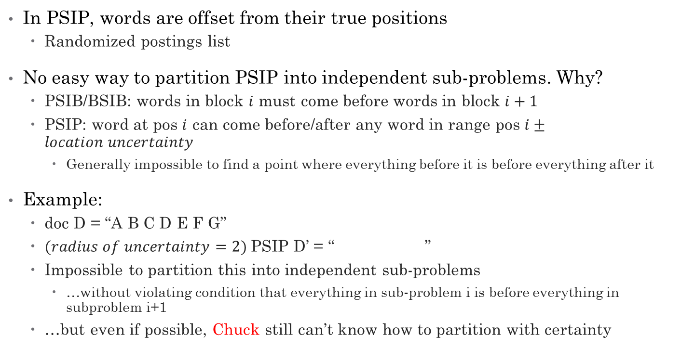
PSIP, Chuck’s (second-most) worst nightmare
In PSIP, words are offset from their true positions
Randomized postings list
No easy way to partition PSIP into independent sub-problems. Why?
PSIB/BSIB: words in block $i$ must come before words in block $i+1$
PSIP: word at pos $i$ can come before/after any word in range pos $i±location uncertainty$
Generally impossible to find a point where everything before it is before everything after it
Example:
doc D = “A B C D E F G”
$(radius of uncertainty=2)$PSIP D’ = “ ”
Impossible to partition this into independent sub-problems
…without violating condition that everything in sub-problem i is before everything in subproblem i+1
…but even if possible, Chuck still can’t know how to partition with certainty
Notes:
Impossible to partition into independent sub-problems w/o violating condition that everything in sub-problem $i$ is before (or after) everything in sub-problem $i+1$

Slide 39
PSIM, Chuck’s worst nightmare
PSIM only stores minimum pairwise location information
No absolute location information known!
No way to effectively reduce problem into simpler sub-problems
Has other problems though:
Large index size
Can’t answer absolute location queries
Best of both worlds: combine PSIM with another secure index

Slide 40
Counter-measures against Chuck
Didn’t simulate Chuck reconstructing confidential documents from info in secure indexes
Only simulate him attacking query privacy
Designed and implemented counter-measures against hypothetical Chuck
Evaluated counter measures:
effects of increasing false positive rate on retrieval relevancy
effects of poisoning secure index on retrieval accuracy
Adding junk terms

Slide 41
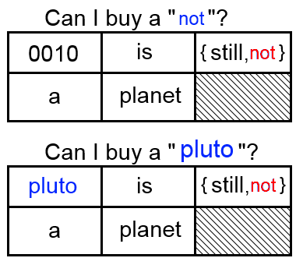
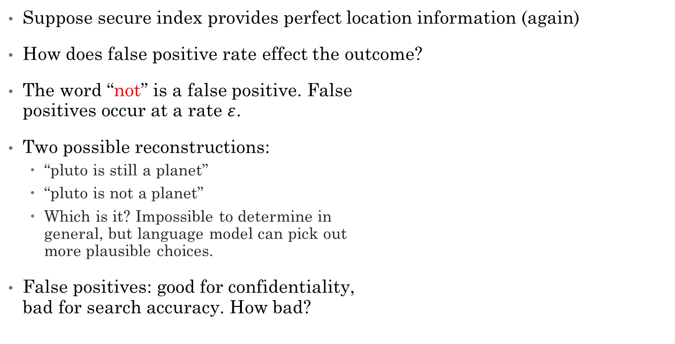
Effect of false positives on doc confidentiality
Suppose secure index provides perfect location information (again)
How does false positive rate effect the outcome?
The word “not” is a false positive. False positives occur at a rate $ε$.
Two possible reconstructions:
“pluto is still a planet”
“pluto is not a planet”
Which is it? Impossible to determine in general, but language model can pick out more plausible choices.
False positives: good for confidentiality, bad for search accuracy. How bad?

Slide 42
False positive rate’s effect on BM25
For PSIP/PSIF, 0.01 decrease in BM25 MAP per 1% increase in false positive rate
25% false positive rate has still has ~70% MAP
BM25 is tolerant of high false positive rates
Why?
BM25 is ranking the docs, so even if a retrieved doc is irrelevant, it may be ranked low
Same story for MinDist

Slide 43
False positive rate’s effect on Boolean search
Boolean search less encouraging
At a false positive rate of 0.25, precision falls to 50%
BM25 is far less sensitive to false positive rate than Boolean search
Why?
BM25 degree of relevancy vs Boolean irrelevant/relevant

Slide 44
Junk terms (secure index poisoning) effect on BM25
Junk terms = fake terms
Increasing junk percentage improves confidentiality
Adversary don’t know which terms are real or fake
…but unlike increasing false positive rate, doesn’t degrade retrieval accuracy
Inflates size though

Slide 45
Junk terms effect on space complexity
Junk percentage only has a small effect on compression ratio
20% junk percentage:
~10% for PSIB
~5% for PSIF
~20% for PSIP
Note: Designed a more space- efficient version of PSIP that also scales better with junk percentage – not implemented

Slide 46
Conclusions (part 1)
Designed several new secure indexes based on PHF
BSIB’s latency is slow—linear time complexity with respect to document size
PSIB most resembles BSIB (block-based) but PSIB is smaller and faster
PSIP had highest overall retrieval accuracy, but poor space complexity
Query privacy vulnerable to adversary with query history data, but obfuscations are a effective counter-measure
Obfuscations have little impact on search accuracy, except for Boolean search
Multiple secrets less helpful, have no impact on search accuracy
If location info stored in secure index, location uncertainty should be large to preserve confidentiality (~at least a page, but no simulations performed)
Adversary cannot reduce PSIP into smaller independent sub-problems like it can for PSIB/BSIB
PSIM doesn’t store location info, just min pairwise distance info

Slide 47
Conclusions (part 2)
Increasing location uncertainty significantly degrades MinDist* accuracy
PSIM to the rescue?
Increasing the false positive rate improves confidentiality and only moderately degrades rank-ordered search accuracy
Rank-ordered search works well despite any approximation errors
Boolean search accuracy significantly degraded
Secure index poisoning also improves confidentiality and doesn’t degrade search accuracy—not even Boolean search
Inflates size of secure indexes

Slide 48
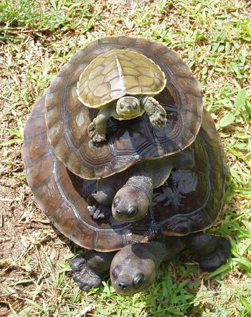
Questions?

